Slide 1

Servlets Marks:14
Prepared by Biradar R.Y.

Slide 2
Specific Objectives:
To write web based applications using servlets
To write servlet for cookies and session
tracking.

Slide 3
What is a Servlet?
Servlet is a technology i.e. used to create web application. Servlet technology is robust and scalable.
Servlet is an API that provides many interfaces and classes including documentations.
Servlet is an interface that must be implemented for creating any servlet.
Servlet is a class that extend the capabilities of the servers and respond to the incoming request. It can respond to any type of requests.
Servlet is a web component that is deployed on the server to create dynamic web page.
Servlet technology is used to create web application (resides at server side and generates dynamic web page).

Slide 4
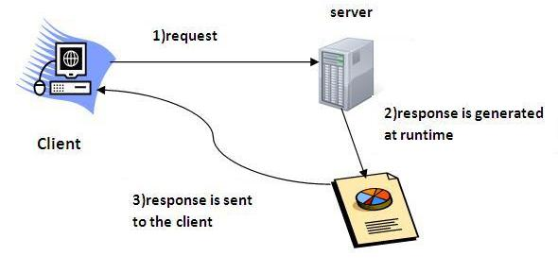

Slide 5
What is web application?
A web application is an application accessible from the web. A web application is composed of web components like Servlet, JSP, Filter etc. and other components such as HTML.
The web components typically execute in Web Server and respond to HTTP request.

Slide 6
CGI(Commmon Gateway Interface)
Before Servlet, CGI (Common Gateway Interface) scripting language was common as a server-side programming language.
CGI technology enables the web server to call an external program and pass HTTP request information to the external program to process the request. For each request, it starts a new process.

Slide 7
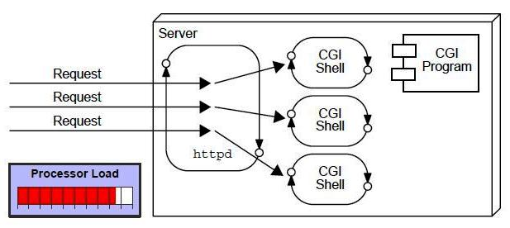

Slide 8
Disadvantages of CGI
There are many problems in CGI technology:
If number of clients increases, it takes more time for sending response.
For each request, it starts a process and Web server is limited to start processes.
It uses platform dependent language e.g. C, C++, Perl.

Slide 9
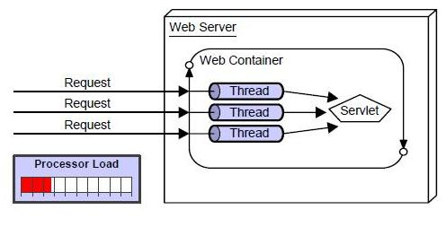
Advantage of Servlet

Slide 10
Advantage of Servlet
better performance: because it creates a thread for each request not process.
Portability: because it uses java language.
Robust: Servlets are managed by JVM so we don't need to worry about memory leak, garbage collection etc.
Secure: because it uses java language.
Faster: because it creates a thread
Platform independent.

Slide 11
SERVLET | CGI(COMMON GATEWAY INTERFACE)
Servlets are portable and efficient. | CGI is not portable
In Servlets, sharing of data is possible. | In CGI, sharing of data is not possible.
Servlets can directly communicate with the web server. | CGI cannot directly communicate with the web server.
Servlets are less expensive than CGI. | CGI are more expensive than Servlets.
Servlets can handle the cookies. | CGI cannot handle the cookies.

Slide 12
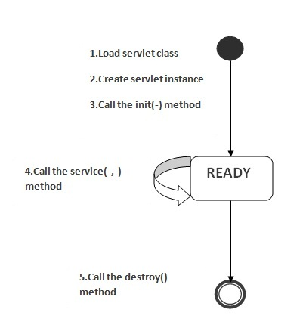
Life Cycle of a Servlet
Servlet life cycle contains five steps:
Loading of Servlet
Creating instance of Servlet
Invoke init() once
Invoke service() repeatedly for each client request
Invoke destroy()

Slide 13
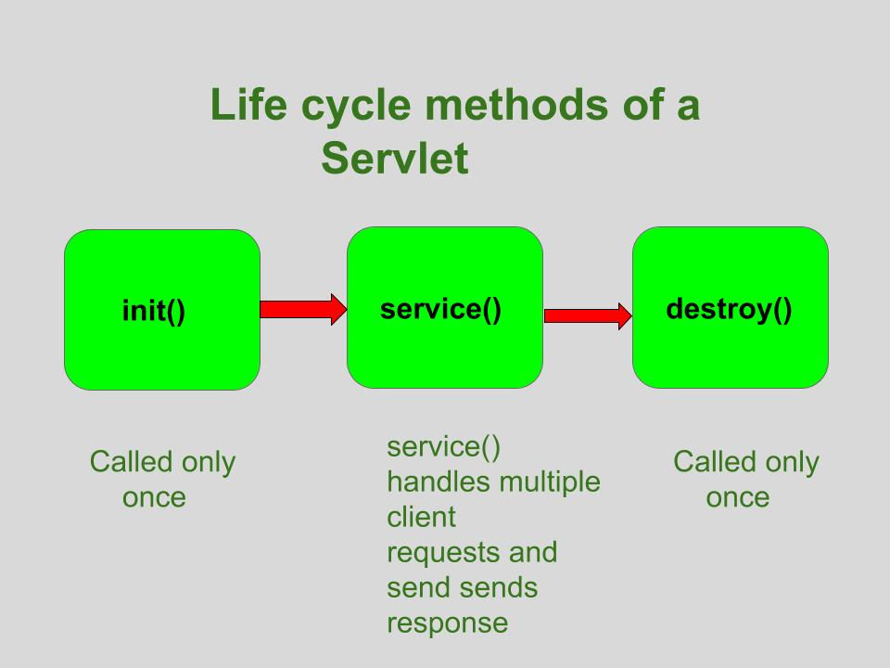
Life cycle of servlet
the entire life cycle of a Servlet is managed by the Servlet container/Web Container

Slide 14
init() method
A servlet’s life begins here .
called only once to load the servlet.
This method receives only one parameter i.e ServletConfig object.
Can throw the ServletException.
Once the servlet is initialized, it is ready to handle the client request.
Syntax:
public void init(ServletConfig con)throws ServletException
{
-----
}

Slide 15
service() method
The web server calls the service() method to handle requests coming from the client( web browsers) and to send response back to the client.
This method determines the type of Http request (GET, POST, PUT, DELETE, etc.) .
This method also calls various other methods such as doGet(), doPost(), doPut(), doDelete(), etc. as required.
Syntax:
void service(ServletRequest req, ServletResponse resp) throws ServletException, IOException
{
-----
}

Slide 16
destroy() method
called only once .
It is called at the end of the life cycle of the servlet.
performs various tasks such as closing connection with the database, releasing memory allocated to the servlet, releasing resources that are allocated to the servlet and other cleanup activities.
When this method is called, the garbage collector comes into action .
Syntax
public void destroy()
{ // Finalization code...
}

Slide 17
Servlet API
Servlet use classes and interfaces from 2 packages
javax.servlet
It contains classes to support generic protocol
javax.servlet.http
It extends classes in servlet package to add HTTP specific functionality.

Slide 18
Interfaces in javax.servlet package
Servlet | It provides 3 life cycle methods.
ServletConfig | Allows Servlets to get initialization parameters
ServletContext | Enables Servlets to access information about their environment.
ServletRequest | Used to read data from a client request.
ServletResponse | Used to write data to a client response.

Slide 19
Classes in javax.servlet package
GenericServlet | Implements Servlet, ServletConfig and Serializable interfaces
ServletInputStream | Provides an input stream for reading requests from client.
ServletOutputStream | Provides an output stream for writing responses to a client.
ServletException | Indicates a Servlet error occurred.
UnavailableException | Indicates a Servlet is unavailable.

Slide 20
Interfaces in javax.servlet.http package
HttpServletRequest | Enables Servlet to read data from HTTP request
HttpServletResponse | Enables Servlet to write data to HTTP response.
HttpSession | Allows session data to be read and written
HttpSessionListener | Interface for receiving notification events about HttpSession lifecycle changes.
HttpSessionBindingListener | Informs an object that is bound to or unbound from a session.

Slide 21
Classes in javax.servlet.http package
HttpServlet | Provides methods to handle HTTP requests and responses.
Cookie | Allows state information to be stored on a client machine.
HttpSessionEvent | Encapsulates session changed event.
HttpSessionBindingEvent | Indicates when a listener is bound or unbound from a session

Slide 22
Servlet Example
The servlet can be created by three ways:
By implementing Servlet interface,
By inheriting GenericServlet class,
By inheriting HttpServlet class

Slide 23
Interfaces in javax.servlet package
1) Servlet
Servlet interface needs to be implemented for creating any Servlet.
It provides 3 life cycle methods:
init(), service(), and destroy()
void init(ServletConfig config) | It initializes the servlet. It is the life cycle method of servlet and invoked by the web container only once.
void service(ServletRequest request,ServletResponse response) | Provides response for the incoming request. It is invoked at each request by the web container.
void destroy() | It is invoked only once and indicates that servlet is being destroyed.

Slide 24
ServletConfig getServletConfig() | returns the object of ServletConfig that contains any initialization parametrs
String getServletInfo() | returns information about servlet such as writer, copyright, version etc.

Slide 25
Interfaces in javax.servlet package
2) ServletConfig
ServletConfig is created by the web container for each servlet.
This object can be used to get configuration information from web.xml file.
we don't need to edit the servlet file if information is modified from the web.xml file.
ServletContext getServletContext() | Returns an object of ServletContext.
String getServletName() | Returns the name of the servlet.
String getInitParameter(String name) | Returns the parameter value for the specified parameter name
Enumeration getInitParameterNames(): | Returns an enumeration of all the initialization parameter names.

Slide 26
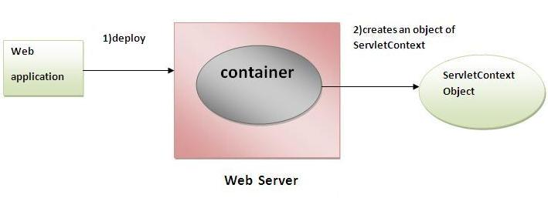
Interfaces in javax.servlet package
3) ServletContext
ServletContext is created by the web container at time of deploying the project.
This object can be used to get configuration information from web.xml file.
There is only one ServletContext object per web application.

Slide 27
Methods of ServletContext
String getInitParameter(String name) | Returns the parameter value for the specified parameter name.
Enumeration getInitParameterNames() | Returns the names of the context's initialization parameters.
void setAttribute(String name,Object object) | sets the given object in the application scope.
Object getAttribute(String name) | Returns the attribute for the specified name.
Enumeration getInitParameterNames(): | Returns the names of the context's initialization parameters as an Enumeration of String objects.
void removeAttribute(String name) | Removes the attribute with the given name from the servlet context.

Slide 28
Interfaces in javax.servlet package
4) ServletRequest
used to provide the client request information to a servlet such as content type, content length, parameter names and values, header informations, attributes etc..
String getParameter(String name) | used to obtain the value of a parameter by name.
String[] getParameterValues(String name) | returns an array of String containing all values of given parameter name.
Enumeration getParameterNames() | returns an enumeration of all of the request parameter names.

Slide 29
Methods of ServletRequest
int getContentLength() | Returns the size of the request entity data, or -1 if not known.
String getCharacterEncoding() | Returns the character set encoding for the input of this request.
String getContentType() | Returns the Internet Media Type of the request entity data, or null if not known.
ServletInputStream getInputStream() throws IOException | Returns an input stream for reading binary data in the request body.
abstract String getServerName() | Returns the host name of the server that received the request.
int getServerPort() | Returns the port number on which this request was received.

Slide 30
Interfaces in javax.servlet package
5) ServletResponse
used to provide the response to the clients request.
response either as character or binary data.
PrintWriter stream can be used to send character data as servlet response, and
ServletOutputStream stream to send binary data as servlet

Slide 31
Methods of ServletResponse
String getCharacterEncoding() | It returns the name of the charset used in the response sent to the client.
String getContentType() | It returns the response content type. e.g. text, html etc..
ServletOutputStream getOutputStream() | Returns a ServletOutputStream suitable for writing binary data in the response.
PrintWriter getWriter() | Returns the PrintWriter object.
void setCharacterEncoding( String charset) | Set the charset (character encoding) of the response.
void setContentLength(int len) | It sets the length of the response body.
void setContentType(String type) | Sets the type of the response data.

Slide 32
Interfaces in javax.servlet.http package
1) HttpServletRequest
extends the ServletRequest interface.
allow request information for HTTP Servlet
String getAuthType() | Returns the name of the authentication scheme used to protect the Servlet.
String getContextPath () | Returns the portion of the request URI that indicates the context of the request.
Cookie [] getCookies ( ) | Returns an array containing all of the cookie objects the client sent with this request.
String getHeader(String name) | Returns the value of the specified request header as a string.
Enumeration getHeaderNames() | Returns an enumeration of all the header names this request contains.

Slide 33
Methods of HttpServletRequest
String getMethod() | Returns the name of the HTTP method with which this request was made,
String getPathlnfo() | Returns any extra path information associated with the URL the client sent when it made this request.
String getQueryString () | Returns the query string that is contained in the request URL after the path.
public HttpSession getSession () | Returns the current session associated with this request, or if the request does not have a session, creates one.
HttpSession getSession(boolean create) . | Returns the current HttpSession associated with this request or, if there is no current session and create is true, returns a new session

Slide 34
Interfaces in javax.servlet.http package
2) HttpServletResponse
void addCookie(Cookie cookie) | Adds the specified cookie to the response. This method can be called multiple times to set more than one cookie.
void addHeader(String name, String value) | Adds a response header with the given name and value.
boolean containsHeader(String name) | Returns a boolean indicating whether the named response header has already been set.
void sendRedirect(string location) throws IOException | Sends a temporary redirect response to the client using the specified redirect location URL.
void setHeader(String name, String value) | Sets a response header with the given name and value.
void setStatus(int sc) | Sets the status code for this response

Slide 35
HTTP Request Methods
GET | Used to retrieve resource representation/information only – and not to modify it in any way.
POST | Used to create a new resource into the collection of resources. For example, customer information, file upload, etc. using HTML forms.
HEAD | Same as GET but returns only HTTP headers and no document body. Header contains the entries such as content-type, content-length, last-modified, etc.
PUT | Used to update existing resource . If the resource does not exist then API may decide to create a new resource or not. For ex. Put an image file on the server.
DELETE | Used to delete resources identified by the Request-URI.

Slide 36
HTTP Request Methods
OPTIONS | Describes the communication options for the target resource.
CONNECT | Establishes a tunnel to the server identified by a given URI.
TRACE | The TRACE method is used to echo the contents of an HTTP Request back to the requester which can be used for debugging purpose at the time of development.

Slide 37
HTTP status/response code
1xx | Informational Response (100–199) It means the request has been received and the process is continuing.
2xx | Successful Response( 200-299) It means the action was successfully received, understood, and accepted.
3xx | Redirection (300-399) It means further action must be taken in order to complete the request.
4xx | Client Errors (400-499) It means the request contains incorrect syntax or cannot be fulfilled.
5xx | Server Errors (500-599) It means the server failed to fulfill an apparently valid request.

Slide 38
HTTP status/response code
200 | Ok
201 | Created
400 | Bad Request
403 | Forbidden
404 | Not Found
500 | Internal Server Error
503 | Service Unavailable

Slide 39
What is the difference between Get and Post?
GET | POST
1) In case of Get request, only limited amount of data can be sent because data is sent in header. | In case of post request, large amount of data can be sent because data is sent in body.
2) Get request is not secured because data is exposed in URL bar. | Post request is secured because data is not exposed in URL bar.
3) Get request can be bookmarked | Post request cannot be bookmarked
4) GET requests remain in the browser history | POST requests do not remain in the browser history
5) Get request have length restrictions | Post request have no restrictions on data length.
6) GET is used to request data from a specified resource | POST is used to send data to a server to create/update a resource.

Slide 40
Interfaces in javax.servlet.http package
3) HttpSession
container creates a session id for each user.
this id can be used to identify the particular user.
An object of HttpSession can be used to perform two tasks:
bind objects
view and manipulate information about a session, such as the session identifier, creation time, and last accessed time.

Slide 41
How to get the HttpSession object ?
The HttpServletRequest interface provides two methods to get the object of HttpSession
public HttpSession getSession () | Returns the current session associated with this request, or if the request does not have a session, creates one.
HttpSession getSession(boolean create) | Returns the current HttpSession associated with this request or, if there is no current session and create is true, returns a new session

Slide 42
Methods of HttpSession
String getId() | Returns a string containing the unique identifier value
long getCreationTime() | Returns the time when this session was created.
long getLastAccessedTime() | Returns the last time the client sent a request associated with this session
invalidate() | Invalidates this session then unbinds any objects bound to it.

Slide 43
GenericServlet class
implements Servlet, ServletConfig and Serializable interfaces.
provides the implementation of all the methods of these interfaces except the service method
can handle any type of request
it is protocol-independent

Slide 44
HttpServlet class
extends the GenericServlet class and implements Serializable interface.
provides http specific methods such as doGet, doPost, doHead, doTrace etc.
can handle only HTTP request
it is protocol-dependent

Slide 45
import javax.servlet.http.*;
import javax.servlet.*;
import java.io.*;
public class DemoServlet extends HttpServlet{
public void doGet(HttpServletRequest req,HttpServletResponse res)
throws ServletException,IOException
{
res.setContentType("text/html");//setting the content type
PrintWriter pw=res.getWriter();//get the stream to write the data
//writing html in the stream
pw.println("<html><body>");
pw.println("Welcome to servlet");
pw.println("</body></html>");
pw.close();//closing the stream
}}

Slide 46
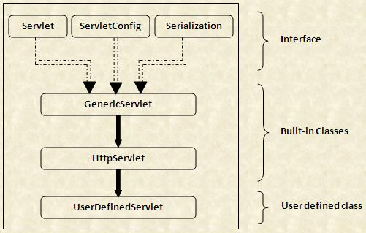
Servlet Class Hierarchy

Slide 47
Cookies in Servlet
A cookie is a small piece of information that a
web application can store on the client machine of users. It is sent by the server to the browser.
4 kilo bytes of data
A cookie has a name, a single value, and optional attributes such as a comment, path and domain qualifiers, a maximum age, and a version number.
Cookie data comes in name-value pairs.

Slide 48
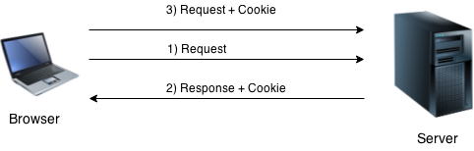
How Cookie works?
By default, each request is considered as a new request. In cookies technique, we add cookie with response from the Servlet. So cookie is stored in the cache of the browser. After that if request is sent by the user, cookie is added with request by default. Thus, we recognize the user as the old user.

Slide 49
Types of Cookie
2 types of cookies in servlets:-
Non-persistent cookie
Persistent cookie
Non-persistent cookie
It is valid for single session only. It is removed each time when user closes the browser.
Persistent cookie
It is valid for multiple session . It is not removed each time when user closes the browser. It is removed only if user logout or signout.

Slide 50
Advantage of Cookies
Simplest technique of maintaining the state.
Cookies are maintained at client side.
Disadvantage of Cookies
It will not work if cookie is disabled from the browser.
Only textual information can be set in Cookie object.

Slide 51
Cookie class
javax.servlet.http package contains Cookie class
Constructor
Cookie() : constructs a cookie
Cookie(String name, String value) :constructs a cookie with a specified name and value.
For adding cookie or getting the value from the cookie,
void addCookie(Cookie ck) | method of HttpServletResponse interface is used to add cookie in response object.
Cookie[] getCookies() | method of HttpServletRequest interface is used to return all the cookies from the browser

Slide 52
Methods
void setMaxAge(int expiry) | Sets the maximum age of the cookie in seconds.
Int getMaxAge() | Returns the maximum age of the cookie in seconds.
String getName() | Returns the name of the cookie. The name cannot be changed after creation.
void setName(String name) | changes the name of the cookie.
String getValue() | Returns the value of the cookie.
void setValue(String value) | changes the value of the cookie.
String getpath() | Returns the path.
boolean getSecure() | Returns true if the cookie is secure. Otherwise returns false
void setSecure(boolean secure) | Sets the security flag.

Slide 53
import java.io.*;
import javax.servlet.*;
import javax.servlet.http.*;
public class AddCookie extends HttpServlet
{
public void doPost(HttpServletRequest request, HttpServletResponse response)
throws ServletException, IOException
{
response.setContentType("text/html");
PrintWriter out = response.getWriter();
String cl=request.getParameter("color");
//create cookie
Cookie ck=new Cookie("MyCookie",cl);
//add cookie to HTTP response
response.addCookie(ck);
out.println("<h1>Name of the cookie is="+ck.getName());
out.println("<br>value of the cookie is="+ck.getValue());
}
}
<html>
<body>
<form method="post" action="AddCookie">
Select Color=<select name="color">
<option value="Red">Red</option>
<option value="Green">Green</option>
<option value="Blue">Blue</option>
<option value="Pink">Pink</option>
</select>
<input type="submit" value="Submit">
</form>
</body>
</html>

Slide 54
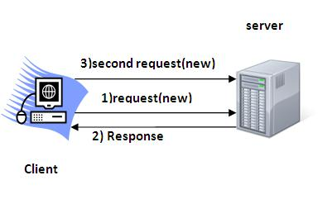
Session Tracking
A session is a conversation between the server and a client. A conversation consists series of continuous request and response.
HTTP is a "stateless" protocol.
Session Tracking is a way to maintain state (data) of an user

Slide 55
Session tracking techniques:
User authorization
Hidden fields
URL rewriting
Cookies
Session tracking API
User authorization:
user will provide username and password to login to the application
Hidden Fields
<INPUT TYPE=”hidden” NAME=”technology” VALUE=”servlet”>

Slide 56
Session tracking techniques:
URL rewriting:
Original URL: http://server:port/servlet/ServletName Rewritten URL: http://server:port/servlet/ServletName?sessionid=7456
Cookies:
Cookie cookie = new Cookie(“userID”, “7456”); res.addCookie(cookie);
Session tracking API:
Java servlets can use the session object to store and retrieve java objects across the session

Slide 57
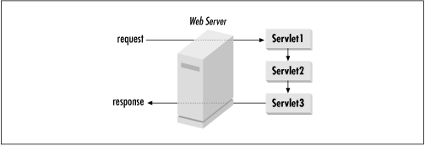
Session chaining and Filtering
A request can be handled by a sequence of Servlets.
The request from the client browser is sent to the first Servlet in the chain.
The response from the last Servlet in the chain is returned to the browser.
In between, the output from each Servlet is passed (piped) as input to the next Servlet, so each Servlet in the chain has the option to change or extend the content.

Slide 58
JSP(Java Server Pages)
JSP technology is used to create web application just like Servlet technology.
An extension to servlet because it provides more functionality than servlet such as expression language, jstl etc.
A JSP page consists of HTML tags and JSP tags.
Helps developers insert java code in HTML pages by making use of special JSP tags, most of which start with <% and end with %>

Slide 59
Advantage of JSP over Servlet
1) Extension to Servlet
JSP technology is the extension to servlet technology.
We can use all the features of servlet in JSP.
we can use implicit objects, predefined tags, expression language and Custom tags in JSP, that makes JSP development easy.
2) Easy to maintain
JSP can be easily managed because we can easily separate our business logic with presentation logic.

Slide 60
3)Fast Development: No need to recompile and redeploy
If JSP page is modified, we don't need to recompile and redeploy the project.
4) Less code than Servlet
In JSP, we can use a lot of tags such as action tags, jstl, custom tags etc. that reduces the code. Moreover, we can use implicit objects etc.

Slide 61
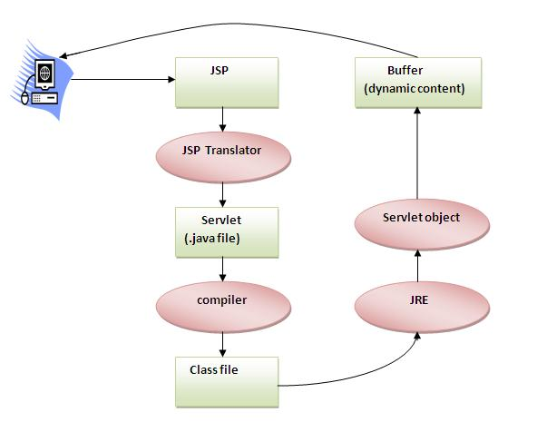
Life cycle of a JSP Page

Slide 62
JSP Lifecycle
JSP Compilation: Involves three steps
Parsing the JSP.
Turning the JSP into a servlet.
Compiling the servlet.
JSP Initialization:
public void jspInit(){ // Initialization code... }
JSP Execution:
void _jspService(HttpServletRequest request, HttpServletResponse response) { // Service handling code... }
JSP Cleanup:
public void jspDestroy() { // cleanup code goes here. }

Slide 63
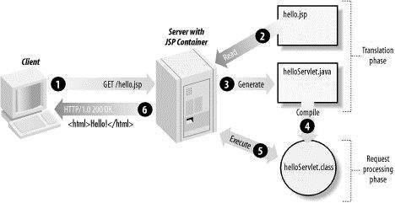
JSP Working

Slide 64
JSP Scriptlet tag
A scriptlet tag is used to execute java source code in JSP.
The jsp scriptlet tag can only declare variables not methods.
scriptlet tag is placed inside the _jspService() method.
Syntax
<% java code fragment %>
Also can be write
<jsp:scriptlet> code fragment </jsp:scriptlet>
Ex: <% out.print("welcome to jsp"); %>

Slide 65
JSP Declarations tag
A declaration declares variables (fields) or methods.
jsp declaration tag is placed outside the _jspService() method.
Syntax:
<%! field or method declaration%>
Or:
<jsp:declaration> code fragment </jsp:declaration>
Ex:
<%! int i = 50; %> <%! int a, b, c; %>
<%! Circle a = new Circle(2.0); %>
<%! int cube(int n) { return n*n*n*; } %>

Slide 66
JSP expression tag
The code placed within JSP expression tag is written to the output stream of the response.
It is mainly used to print the values of variable or method.
No need to write out.print() to write data .
Syntax:
<%= expression %>
Or:
<jsp:expression> expression </jsp:expression>
Ex:
<%= "welcome to jsp" %>
<%= "Value of the variable is:"+data %>
<%= "Cube of 3 is:"+cube(3) %>

Slide 67
Example of JSP scriptlet tag that prints the user name
Index.html
<html>
<body>
<form action="welcome.jsp">
<input type="text" name="uname">
<input type="submit" value=“Go"><br>
</form>
</body>
</html>

Slide 68
/*Welcome.jsp*/
<html>
<body>
<%
String name=request.getParameter("uname");
out.print("welcome "+name);
%>
</body>
</html>

Slide 69
Example of JSP expression tag that prints the user name
Index.html
<html>
<body>
<form action="welcome.jsp">
<input type="text" name="uname">
<input type="submit" value=“Go"><br>
</form>
</body>
</html>

Slide 70
/*Welcome.jsp*/
<html>
<body>
<%= “Welcome “+request.getParameter("uname") %>
</body>
</html>

Slide 71
Example of JSP declaration tag that prints the user name
Index.html
<html>
<body>
<form action="welcome.jsp">
<input type="text" name=“no">
<input type="submit" value=“Go"><br>
</form>
</body>
</html>

Slide 72
/*Welcome.jsp*/
<html>
<body>
<%! int num=Integer.parseInt(request.getParameter(“no")); %>
<%= “Number=“+num %>
</body>
</html>

Slide 73
Implicit Objects
There are 9 jsp implicit objects
created by the web container
Object | Type
out | JspWriter
request | HttpServletRequest
response | HttpServletResponse
config | ServletConfig
application | ServletContext
session | HttpSession
pageContext | PageContext
page | Object
exception | Throwable

Slide 74
JSP Directives
The jsp directives are messages that tells the web container how to translate a JSP page into the corresponding servlet.
There are three types of directives:
page directive
include directive
taglib directive
Syntax of JSP Directive
<%@ directive attribute="value" %>

Slide 75
page directive
The page directive defines attributes that apply to an entire JSP page.
used to provide instructions to the container
Syntax of JSP Directive
<%@ page attribute="value" %>

Slide 76
page directive attributes
Attributes of JSP page directive
import
contentType
extends
info
buffer
language
isELIgnored
isThreadSafe
autoFlush
session
pageEncoding
errorPage
isErrorPage

Slide 77
page directive attributes
Ex. of import:
<%@ page import="java.util.Date" %>
Today is: <%= new Date() %>
Ex. of info:
<%@ page info=“displaying date " %>
Today is: <%= new java.util.Date() %>
Ex of errorPage
<%@ page errorPage="myerrorpage.jsp" %>
<%= 100/0 %>

Slide 78
include directive
Includes a file during the translation phase.
Syntax of JSP include directive tag
<%@ include ... %>
Ex. of include
<%@ include file="content.html" %>

Slide 79
taglib directive
used to define a tag library that defines many tags
Syntax of JSP taglib directive tag
<%@ taglib uri="URIToTagLibrary" prefix="tagPrefix" %>
<%@ taglib uri = "http://www.c4learn.com/userlibrary" prefix = "mytag" %>
<html> <body>
<mytag:print/>
</body> </html>

Slide 80
Thank You….

